Slide 1
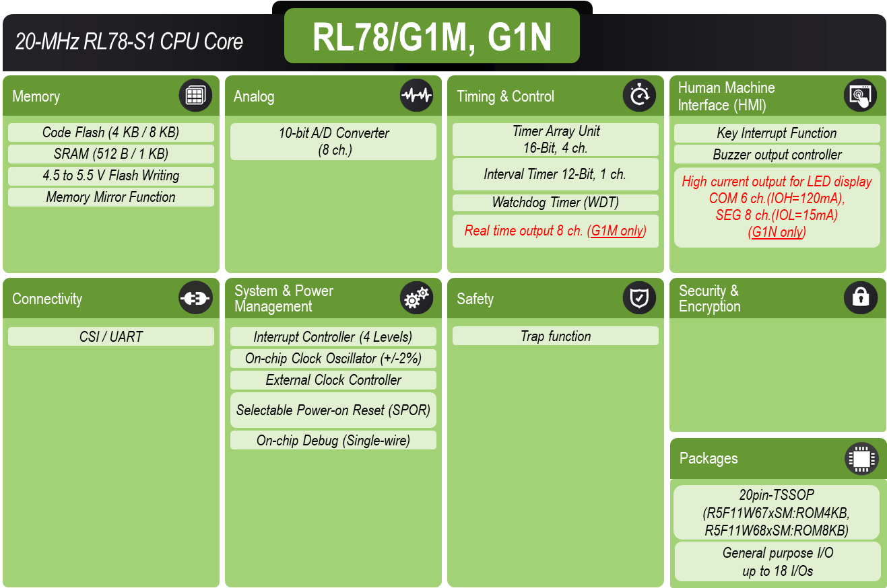
RL78/G1M, G1N MCU Product Snapshot low Pin Count MCU ideal for Simple Motor Control (G1M) & LED Drive (G1N)
Features
Benefits
Applications
Power supply : VDD = 2.0 to 5.5 V
5MHz@2.0~5.5V, 20MHz@2.7~5.5V
8-bit RL78 MCU Core
ROM/RAM: 4KB/512B or 8KB/1KB
High-speed on-chip oscillator (+/- 2.0% accuracy)
I/O ports: 18 High current pin: 6 (G1N only)
16-bit timer: 4ch, Watchdog timer: 1ch
Real-time output: 8ch (G1M only)
Serial interface: CSI 1ch,UART 1ch
8/10-bit ADC: 8ch
Low pin count, Cost-competitive
[RL78/G1M]
Realtime output for motor control
120-degree conducting control (can drive BLDC motors)
[RL78/G1N]
High current output for LED display (COM 6ch;120mA(duty;45%), SEG 8ch;15mA) (can directly drive super luminosity LED, 8-segs x 6-digits)
[RL78/G1M]
Small appliance, Toy (DC motor)
OA/Camera/Louver for Air-con. (Stepping motor)
Fan/Pomp/Electric tool/Refrigerator (BLDC motor)
[RL78/G1N]
Small appliance
Simple lighting
LED Display for equipment
Block Diagram & Development Tools
RL78/G1M, G1N Block Diagram
Development Tools
Item | Tool Name
Proprietary IDE | CS+, e² studio
Compiler | C Compiler Package
Emulator | E1/E2 emulator, E2 emulator Lite
Programmer | PG-FP6, Renesas Flash Programmer
Flash Library | Code Flash Library
Evaluation Kits | RL78/G1M, G1N Fast Prototyping Board
Notes:
1

Slide 2
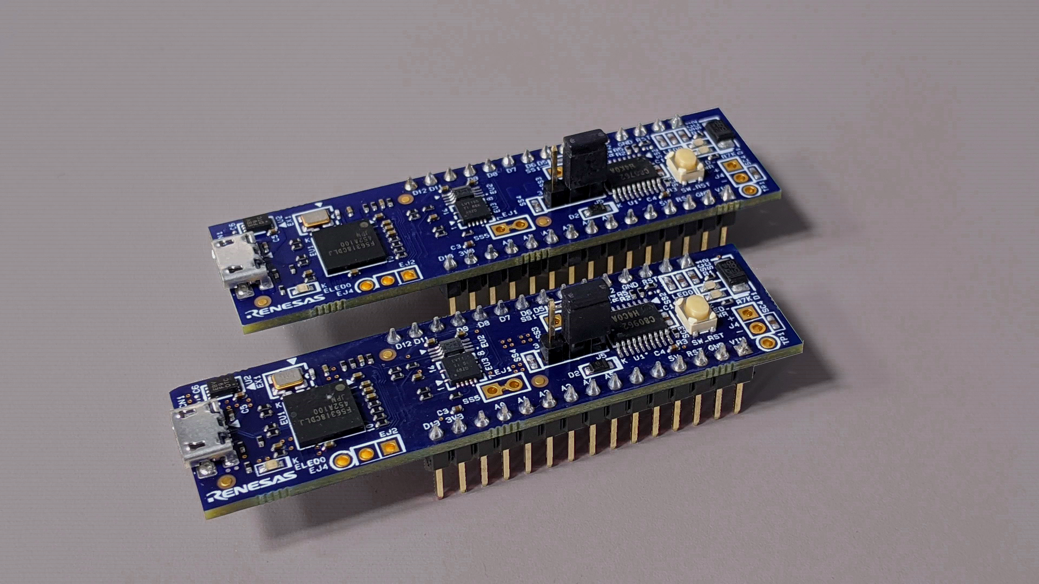
RL78/G1M, G1N Fast Prototyping Board Compact and Cost-Effective with On-Board Emulator Circuit
Features
Benefits
Applications
Equipped with RL78/G1M or RL78/G1N 8-bit MCU (20pin, ROM/RAM: 8KB/1KB)
Built-in emulator circuit equivalent to E2 emulator Lite
Access to all pins of RL78/G1M or RL78/G1N
Arduino Nano and Pmod™ interfaces
No additional tools are required for program debugging/writing with the built-in emulator circuit equivalent to E2 emulator Lite.
The standard Arduino Nano and Pmod™ interfaces for easy expansion.
Debugging is easy with the Arduino Nano header combined use function which provides access to all pins of the target microcontroller.
[RL78/G1M]
Small appliance, Toy (DC motor)
OA/Camera/Louver for Air-con. (Stepping motor)
Fan/Pomp/Electric tool/Refrigerator (BLDC motor)
[RL78/G1N]
Small appliance
Simple lighting
LED Display for equipment
Outline & Board Layout
Notes:
2

